Slide 1

Spotify Song Genre Prediction
Ivan Escalona, Daisy Khamphakdy, Iris Lew, Shuo Wang, Amanda Teschko
W207, MIDS

Slide 2
Dataset
Kaggle link: https://www.kaggle.com/datasets/mrmorj/dataset-of-songs-in-spotify
Dimension: 42305 rows x 22 columns
Features:
‘danceability', 'energy', 'key', 'loudness', 'mode', 'speechiness', 'acousticness', 'instrumentalness', 'liveness', 'valence', 'tempo', 'type', 'id', 'uri', 'track_href', 'analysis_url', 'duration_ms', 'time_signature', 'genre', 'song_name', 'Unnamed: 0', 'title'
Data dictionary:
https://developer.spotify.com/documentation/web-api/reference/#/operations/get-audio-features
https://docs.google.com/document/d/1LWl88F8wGY1WkkOSzzVzwSYij1yeMR8hFXllRpkMyrI/edit

Slide 3
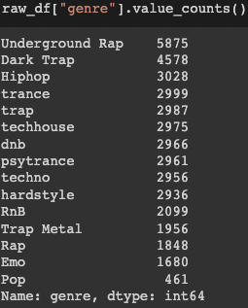
Goal:
Goal: Spotify executives have asked the data science team to have its music app automatically recognize a song’s genre when a song plays, rather than manually classifying a song genre. This will help improve song library customization by learning what song genres are listened to most.
How?: The data science team will build machine learning models that will learn to distinguish songs based on key audio features. The team will then determine the best model for predicting and recognizing song genres.

Slide 4
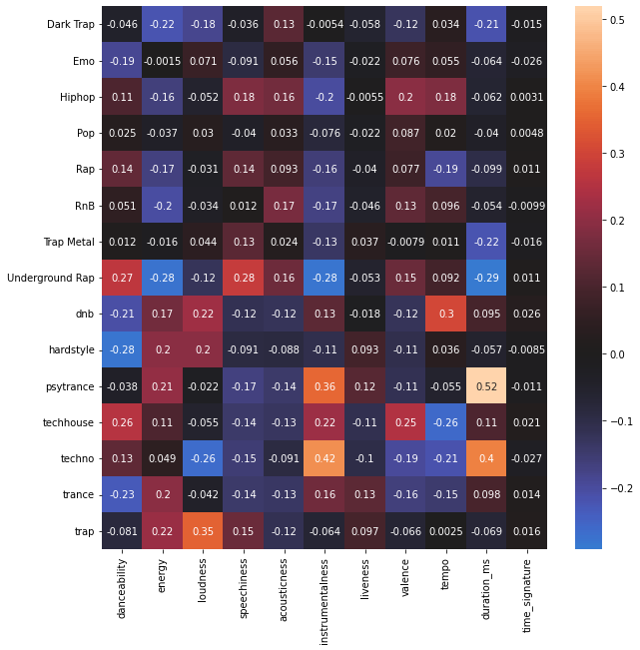
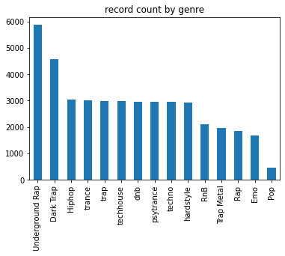
EDA & Findings - Target Variable
15 genres exist in the data
Underground Rap is the most common; Pop is the least common

Slide 5
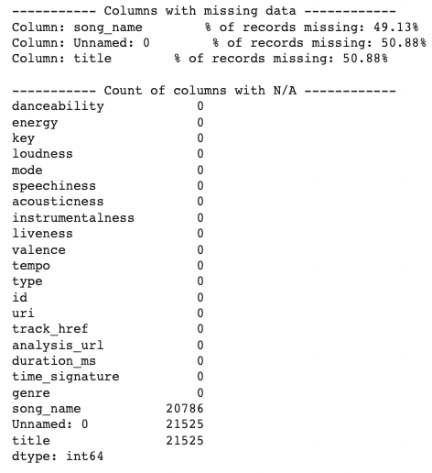
EDA & Findings
Missing data:
Dropped song_name and Unnamed:0 columns because too much data was missing (~50% missing)

Slide 6
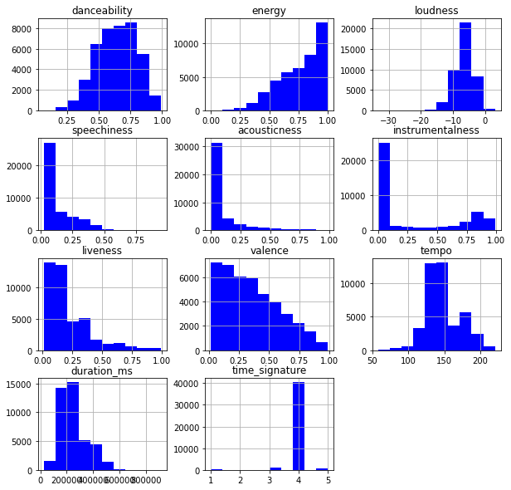
EDA & Findings - Numeric Variable Histograms
Danceability, loudness, and tempo have roughly normal distributions
Speechiness, acousticness, and instrumentalism have large spikes at 0, suggesting a large number of songs don’t have these characteristics present
Time series has only 5 values and may be better considered categorically

Slide 7
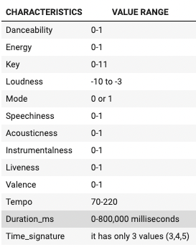
EDA & Findings - Numeric Variable Ranges
Value ranges are 0-1 for most features, but not all
We may want to scale loudness, tempo, and duration to have a value between 0 and 1.
Time_signature and Key may be best used as categorical or ordinal variables

Slide 8
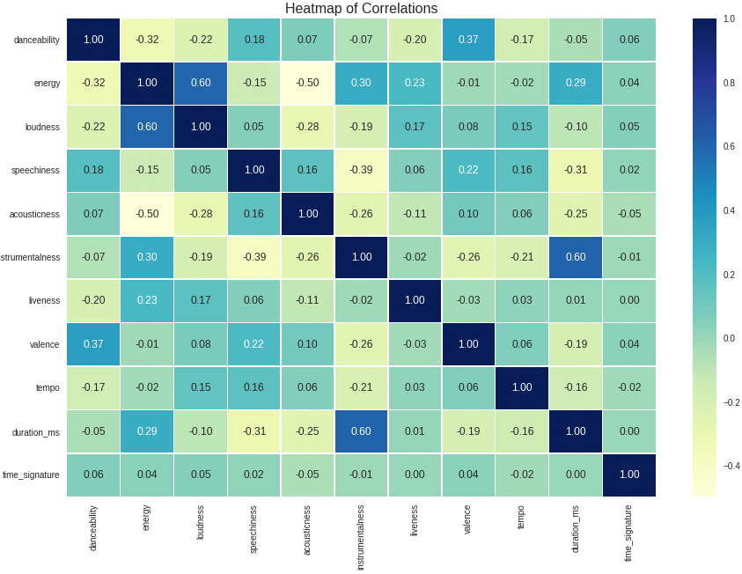
EDA & Findings - Numeric Variable Correlations
Some correlation exists between:
Energy and loudness (.6)
Instrumentalness and duration (.6)
Acousticness and energy (-.5)
Correlation isn’t so high that we’d exclude variables in initial models

Slide 9
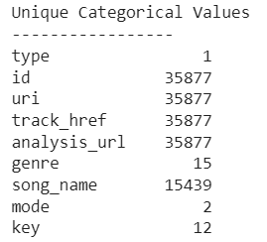
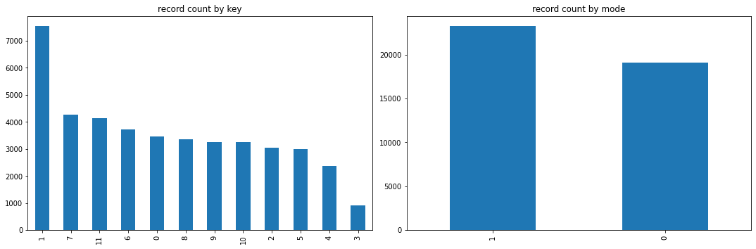
EDA & Findings - Categorical Features
Categorical columns:
Remove columns with a unique value per record -> id, uri, track_href, analysis_url
Removed ‘type’ because all had the same value
Only Key and Mode made sense to include

Slide 10
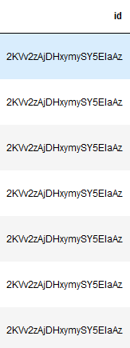
EDA & Findings - Duplicates
If we examine by id, there are duplicates, but every row is unique when we examine the complete dataset.
There are 6,428 duplicates, and after dropping them, we are left with 35,877 rows.

Slide 11
EDA & Findings - Outliers
Numeric Feature | % of outliers
danceability | 0.11
energy | 0.33
loudness | 1.88
speechiness | 4.53
acousticness | 12.17
instrumentalness | 0.00
liveness | 5.90
valence | 0.00
tempo | 1.26
duration_ms | 2.88
time_signature | 4.44
Outlier detection method
1.5IQR method
IQR = Q3 - Q1
Any data point outside (-1.5IQR, 1.5*IQR) is considered an outlier
Results
Some good features with less than 1% of outliers (including a couple zeros)
Some in the range of 1% to 3% and some even as high as 12%.
What will we do?
Analyze whether there’s significant data loss if we were to delete those records.
Worse case scenario (unlikely): 14k records will be deleted.

Slide 12
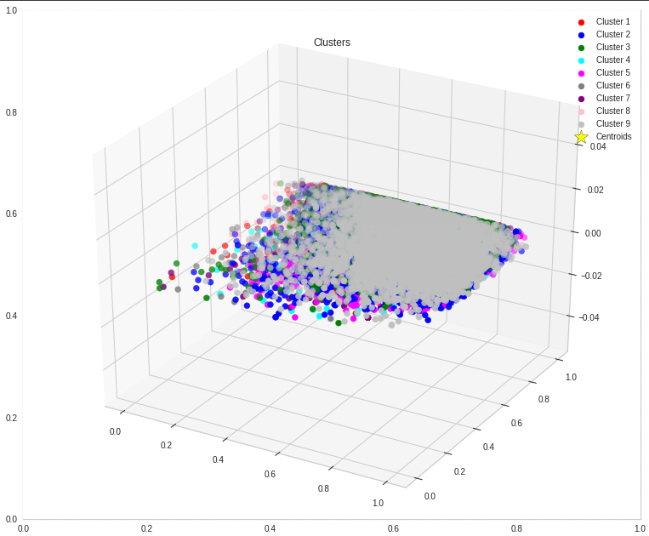
How will we solve the problem?
Build, test, and compare machine learning models to determine the best model for song genre prediction.
Kmeans
KNN
Logistic Regression
Random Forest
Gradient Boosting
Neural Network

Slide 13
Random Forest example
Numeric Feature | precision | recall | f1-score | support
Dark Trap | 0.5275 | 0.4607 | 0.4918 | 458
Emo | 0.7622 | 0.6488 | 0.7010 | 168
Hiphop | 0.4960 | 0.4059 | 0.4465 | 303
Pop | 0.0000 | 0.0000 | 0.0000 | 46
Rap | 0.7833 | 0.2541 | 0.3837 | 185
RnB | 0.4709 | 0.3857 | 0.4241 | 210
Trap Metal | 0.4490 | 0.2256 | 0.3003 | 195
Underground Rap | 0.4207 | 0.6865 | 0.5217 | 587
dnb | 0.9631 | 0.9663 | 0.9647 | 297
hardstyle | 0.8243 | 0.8776 | 0.8501 | 294
psytrance | 0.9338 | 0.9054 | 0.9194 | 296
techhouse | 0.8635 | 0.9158 | 0.8889 | 297
techno | 0.8885 | 0.8615 | 0.8748 | 296
trance | 0.7982 | 0.8833 | 0.8386 | 300
trap | 0.8125 | 0.8696 | 0.8401 | 299
 |  |  | Test accuracy | 0.6814
Hyperparameters
max_depth=None
n_estimators=460,
criterion='gini',
max_features = 'sqrt',
min_samples_split = 6,
min_samples_leaf=9
The rest are the default parameters

Slide 14
What’s pending?
Machine Learning Models
Supervised
Rank | Model | Train Accuracy | Test Accuracy
1 | XGBoost | 0.7794 | 0.6972
2 | Random Forest | 0.7850 | 0.6814
3 | KNN (K=1) | 0.9321 | 0.3836
4 | Logistic Regression | 0.2222 | 0.2200
5 | Neural Network | 0.1736 | 0.0000
Outlier analysis
Complete the development of the K-Means model
Improve accuracy on some of the models
Debug Neural Network model
Compare and analyze models

Slide 15
Old Slides

Slide 16
How will we solve the problem?
Feature developing
Ratio, eg: instrumentalness / liveness
Multiply, eg: speechiness x Danceability
etc.
Correlation
Energy vs Loudness
Etc.

Slide 17
Problem Statement
Genre prediction based on song characteristics
Create clusters & kmeans
Song title - multiclass classification
more rnb songs have ‘love’, etc.
smaller dataset. (Non english songs in dataset)
Business case (algorithm and classify it for spotify internally)
Song recommendation (KNN, kmeans, etc.)
Similar song played next?
business scenario of the next closest song
Song with a different genre
Measure of success

Slide 18
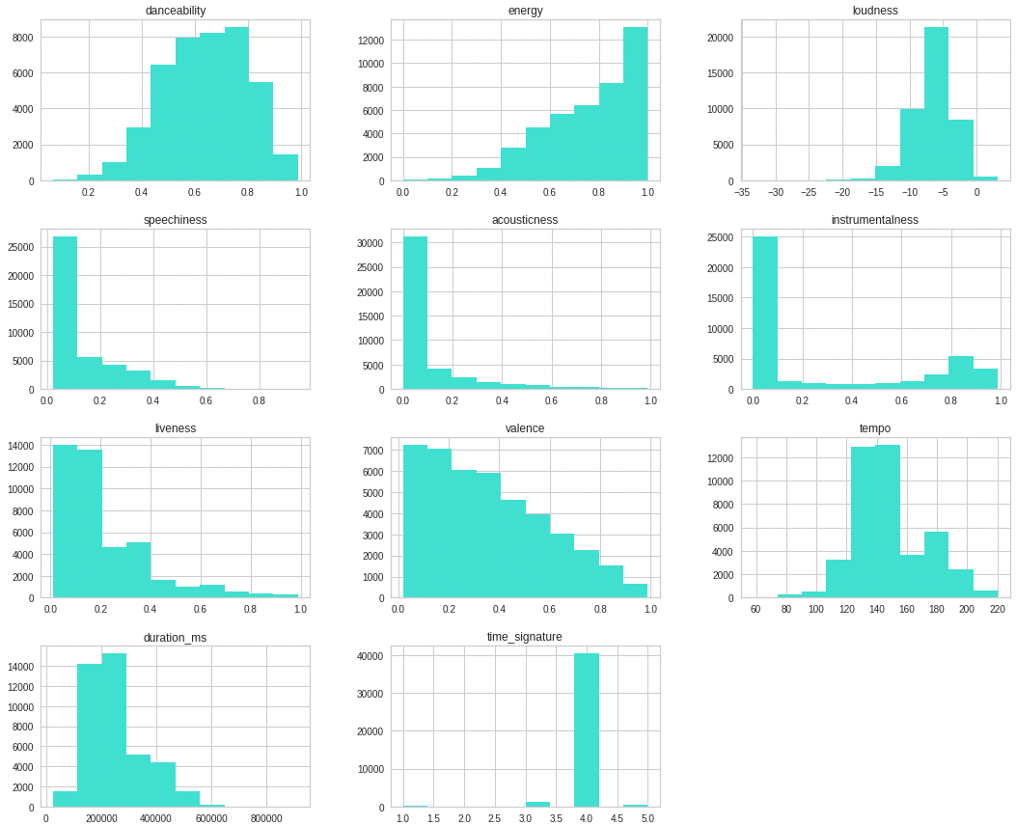
EDA & Findings
EDA-numerical data
(1) Missing rate, (2) Historical gram, (3) Missing data, (4) outliers, (5) Normalize
EDA-Categorical data
(1) Missing data, (2) List, (3) missing data, (4) Categorical to numerical

Slide 19
How will we solve the problem?
Song title - multiclass classification
more rnb songs have ‘love’, etc.
smaller dataset. (Non english songs in dataset)
Business case (algorithm and classify it for spotify internally)
Song recommendation (KNN, kmeans, etc.)
Similar song played next?
business scenario of the next closest song
Song with a different genre
Measure of success

Slide 20
Baseline Model
Model creation
Model 1 – Gradient Boosting Machine
Model 2 – Random forest
Model 3 – Neural Network model
Model 4 – KNN
Model 5 – GMM
Hyper parameter tuning / cross validation
Model testing performance / Model evaluation

Slide 21
How will we solve the problem?
KNN algorithm (Supervised Learning)
Classify songs based on the similarities in earlier stored song characteristics.
Identify meaningful groups and clusters based on similarities in song characteristics.
Make predictions
Multiclass classification (Supervised Learning)
Categorize song genre based on similar song characteristics.
Make predictions.
Measure success

Slide 22
Baseline Model
Model creation
Multiclass - logistic regression (20% so far….)
Kmeans
KNN
Gradient Boosting
Random forest
Neural Network
Hyper parameter tuning / cross validation
Model testing performance / Model evaluation

Slide 23
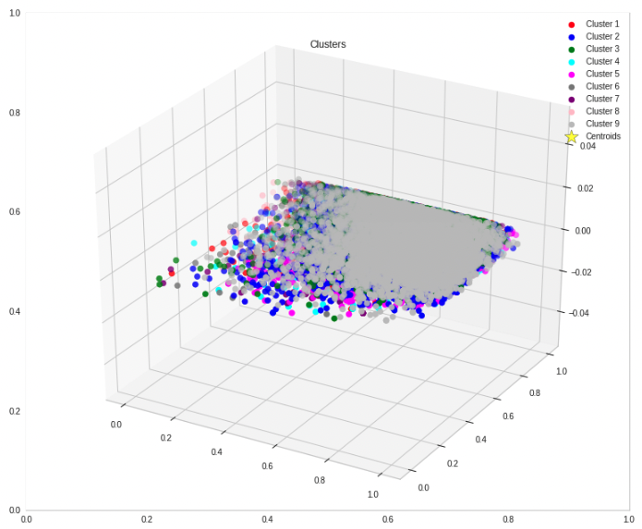
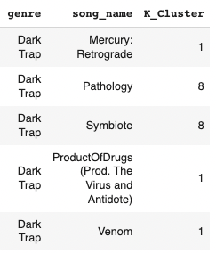
Kmeans Process
Organize our songs into clusters based on common song characteristics
Organize our songs into clusters based on common song characteristics

Slide 24
Random Forest (sklearn)
Results
Hyperparameters
max_depth=None
n_estimators=460,
criterion='gini',
max_features = 'sqrt',
min_samples_split = 6,
min_samples_leaf=9
The rest are the default parameters

Slide 25
XGBoost (sklearn)
Hyperparameters
max_depth=3
n_estimators=280,
learning_rate=0.1
The rest are the default parameters

Slide 26
Deep Neural Network (tensorflow)
Work in progress…
Validation accuracy is zero on every epoch.
Training accuracy is not greater than 20%.
Some more debugging needs to be done.

